Slide 1

Group 3 StockPickers
Iteration 1 - Update

Slide 2
Updated Team
Serguei Chervachidze
Implementation Leader
Sylvie Xiang
Group Leader
Jing Tian
Requirement/Security Leader
Duy Nguyen
QA Leader

Slide 3
Iteration 1 update overview
Updated SPPP based on Prof’s comments and stories from Lab 2
Development of SDD and STD documents
Front end and backend integration implemented
Implemented Integration Testing
Implemented Unit Testing

Slide 4
SPPP Update v2
EVIDENCE
EVIDENCE
Timeline
Proposed High level Requirements
Added tasks for iteration 1
Modified and added features from stories developed from Lab 2.
EVIDENCE
Quality Assurance Plan
Added reference to targeted audience for MFA as well as reference SurveyMonkey as the medium to get this MFA completed.

Slide 5
STD Document
Testing Summary
Manual SystemTesting
Unit tests will be written for key functions of the program. Every team member will help with unit tests, but the QA leader will be responsible for developing an adequate amount of unit tests to validate through integration tests. QA leader is also responsible for running unit tests and integration testing.
Site navigation to make sure the app is working properly.
Test various stocks to make sure price and forecast data is displayed
Test print functionality
Unit Test
URL
Get and Post requests for each view
Test Reports
EVIDENCE
Integration testing
Tests use Selenium webdriver
Test selecting a stock and plotting chart works as intended

Slide 6
SDD Document
Software architecture
UI design
Security Design
Algorithms

Slide 7
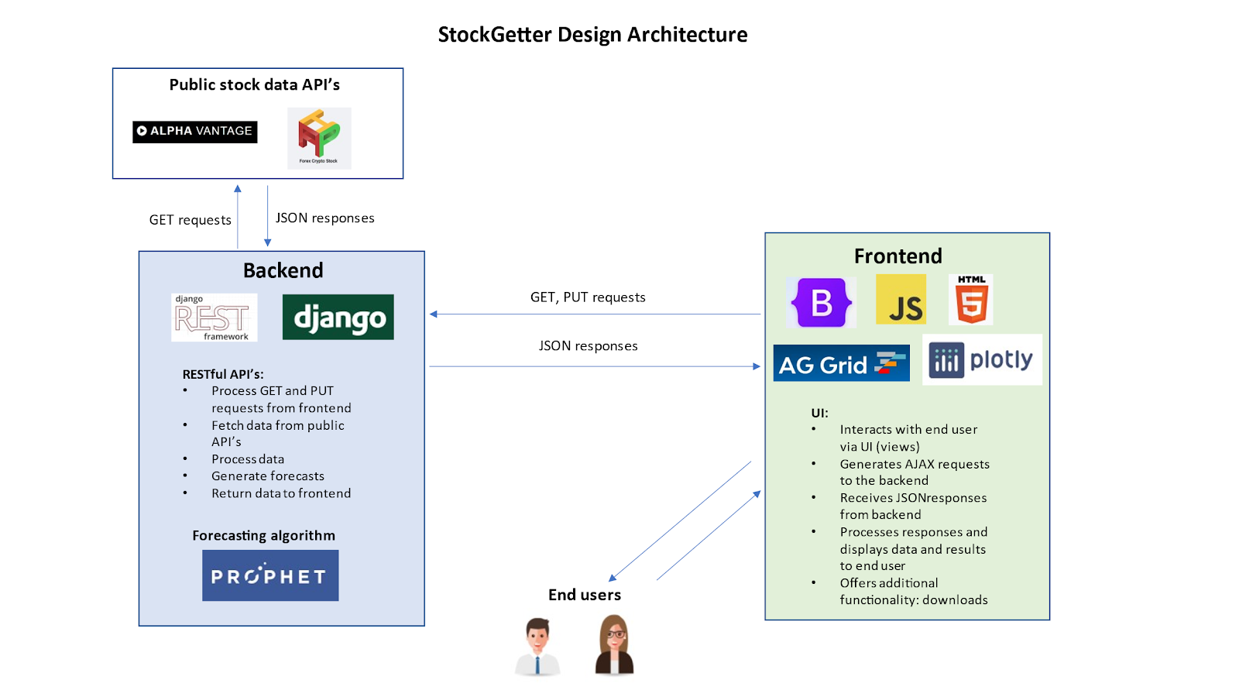
Software architecture

Slide 8
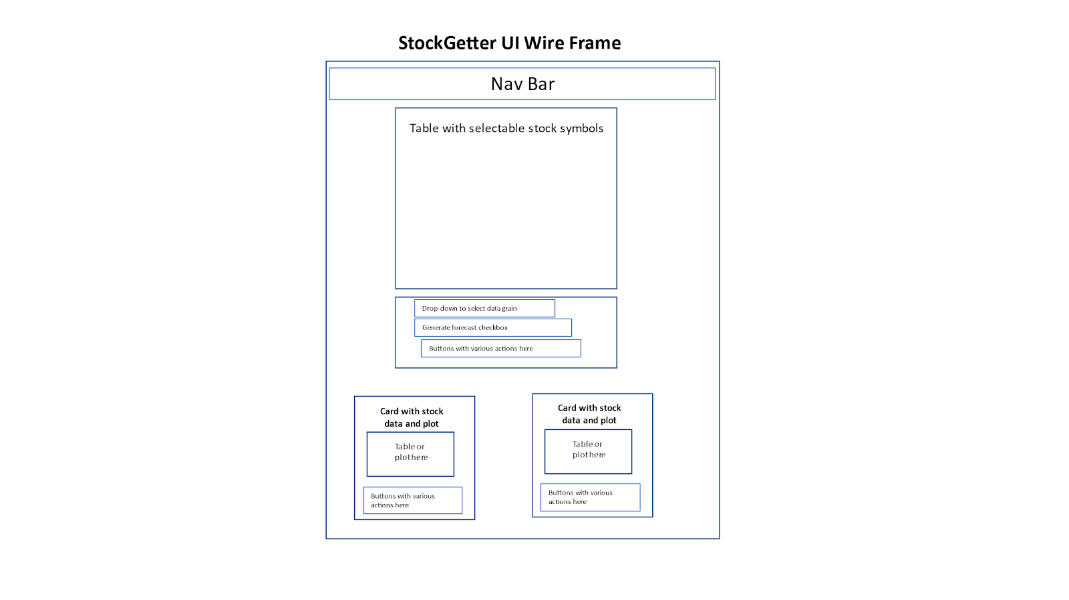
UI design

Slide 9
Security design
The product will implement robust security using the built-in Django security settings and proper practices. Specifically, the product will have the following security settings:
CORS cross-domain protections specified in the backend, allowing only the front-end to interact with the backend (and excluding all other domains)
API keys and other data stored in configuration files and loaded at runtime for each developer or deployment. These will not be committed to the repo by including these in the .gitignore file.

Slide 10
Algorithms
The key algorithm in our implementation is the Facebook Prophet ML algorithm for forecasting time series data: Prophet | Forecasting at scale. (facebook.github.io). This will be implemented on the backend, along with all necessary data pre-processing algorithms needed to interact with the prophet forecasting algorithm.

Slide 11

To Do
Near term
Long term
Keep learning and implement essential features.
Add necessary tests to make each feature works as desired.
Try to implement optional features as much as possible after every essential features are well established and tested

Slide 12
Working Back End and tie to Front End Implementation
Please See Code Demo Video

Slide 13
Thank you
Group 3

Slide 14
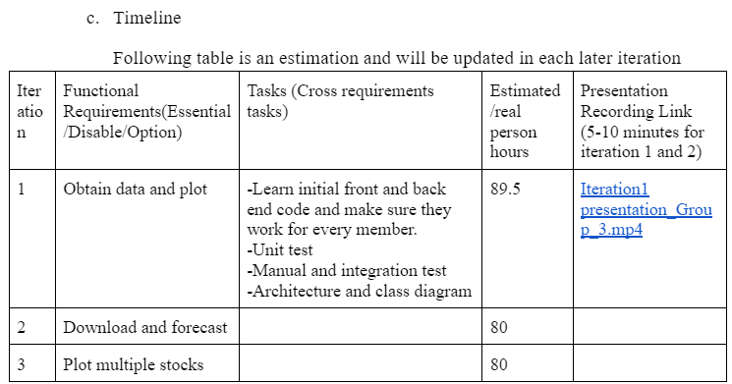
BACK

Slide 15
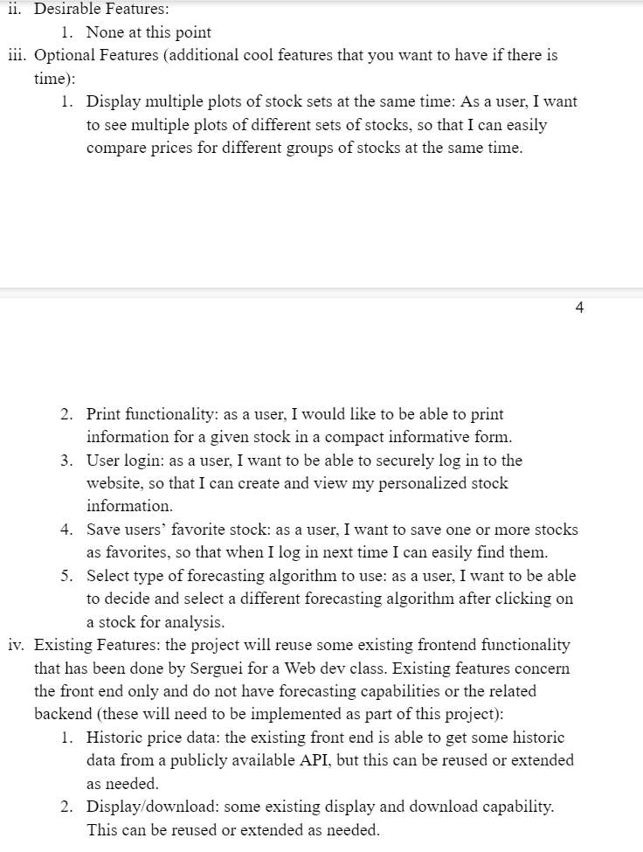
BACK

Slide 16
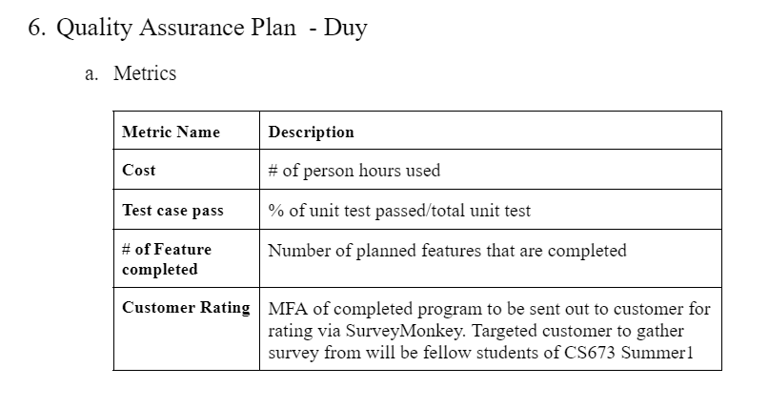
BACK

Slide 17
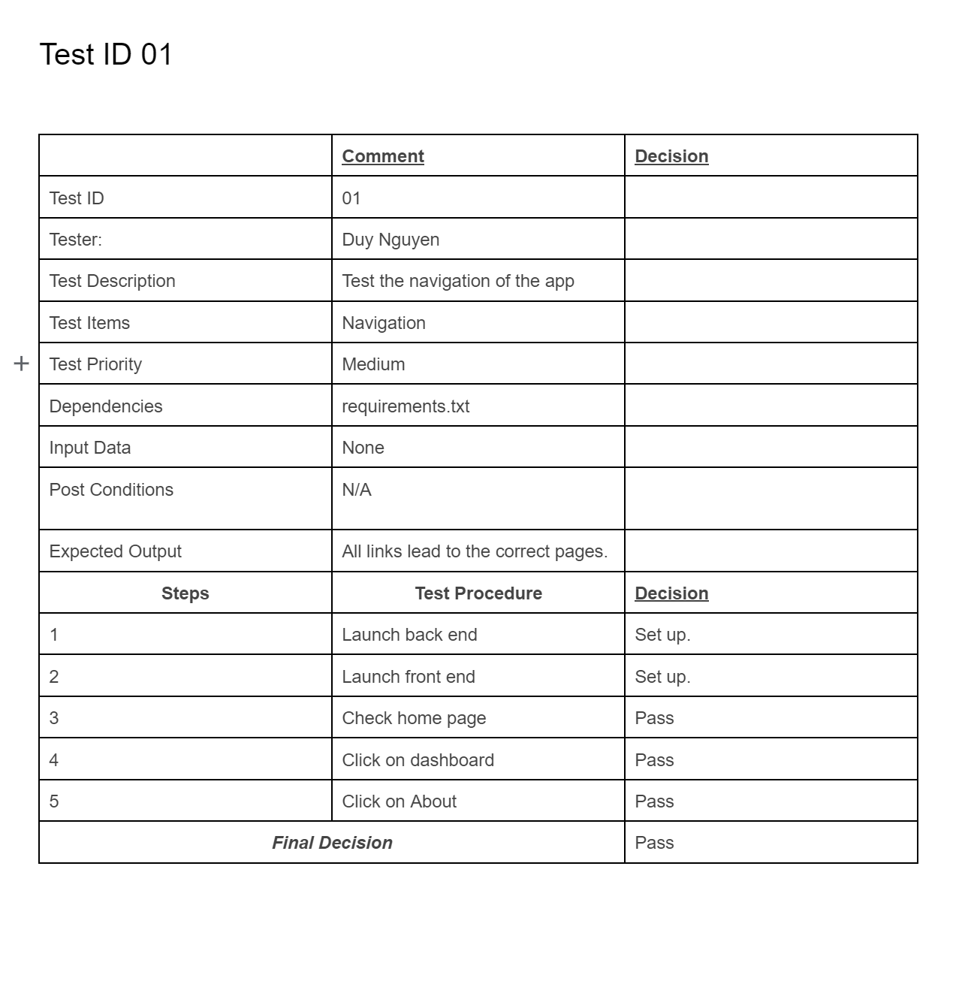
BACK

